Slide 1
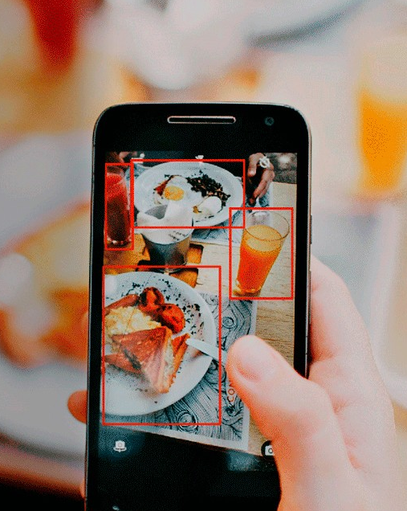

Food Recognition with Deep Learning
Daniele Filippini
Machine Learning
2020/2021
daniele.filippini2@studio.unibo.it

Slide 2
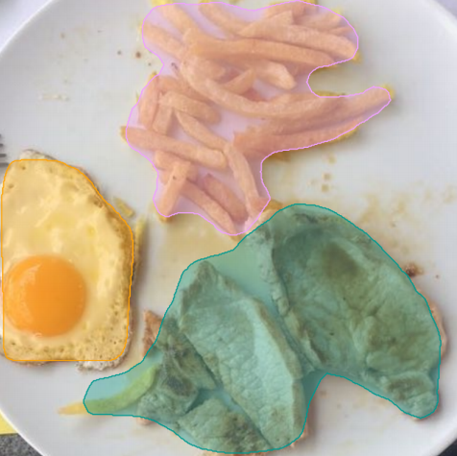
Introduction
Recognizing food from images is an extremely useful tool for a variety of use cases. In particular, it would allow people to track their food intake by simply taking a picture of what they consume.
Image-based food recognition has in the past few years made substantial progress thanks to advances in deep learning. But food recognition remains a difficult problem for a variety of reasons.
For food recognition problems, it is common to use data sets such as Food101, composed of 101 food categories, with 101.000 images. However Food101 does not have images with various food classes, making it difficult to use in real-world settings.
For this reason a novel dataset was built for the AICrowd Food Recognition Challenge. This growing data set has been annotated - or automatic annotations have been verified - with respect to segmentation and classification.

Slide 3
Outline
From object detection to segmentation (networks architectures)
Toolkit
Dataset
Data Exploration
Data Preprocessing
Experimental Studies
Conclusions and Future work

Slide 4
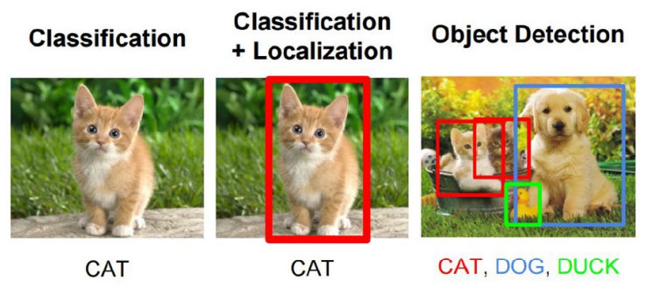
From object detection…
Object recognition is a general term to describe a collection of related computer vision tasks that involve identifying objects in digital photographs.
Localization: localize the object in the image and drawing a bounding box around it
Classification: predict the class of the object in the bounding box
Classification + Localization: we want to classify the image and get the location of the object in the image. Here a fixed number of elements (typically 1) is assumed to be in the image.
Object detection: it’s a more general case of classification + localization, we don’t know how many objects are in the image beforehand. We want to detect all the objects in the image and draw bounding boxes around them

Slide 5
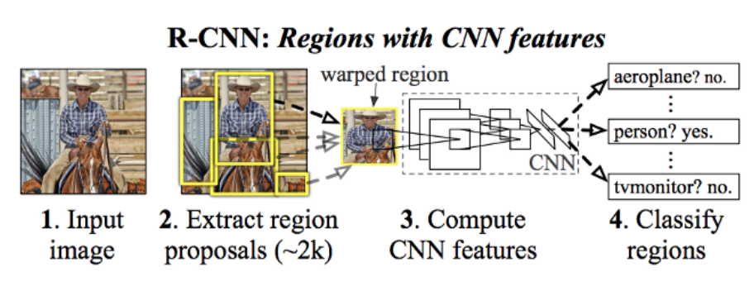
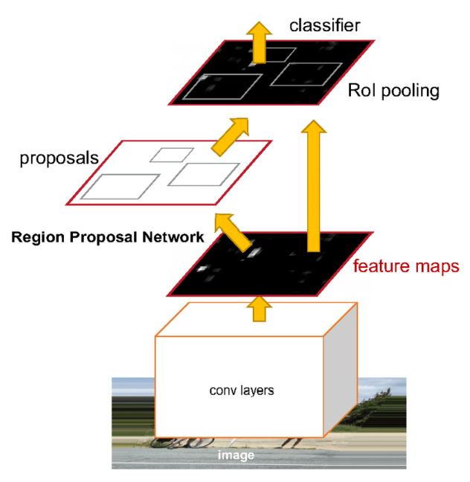
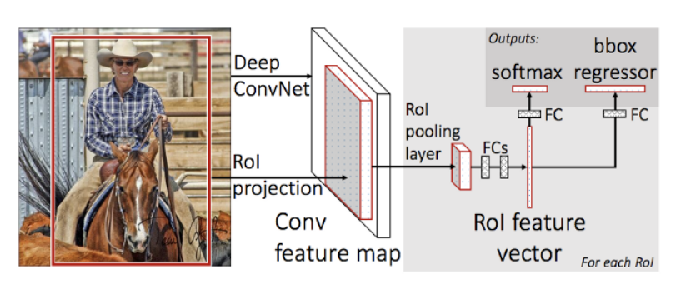
From object detection…
Detection networks: take different regions of interest from the image (objects can have different aspect ratios and spatial locations) and use a CNN to classify the presence of the object within that region.
FASTER RCNN
FAST RCNN

Slide 6
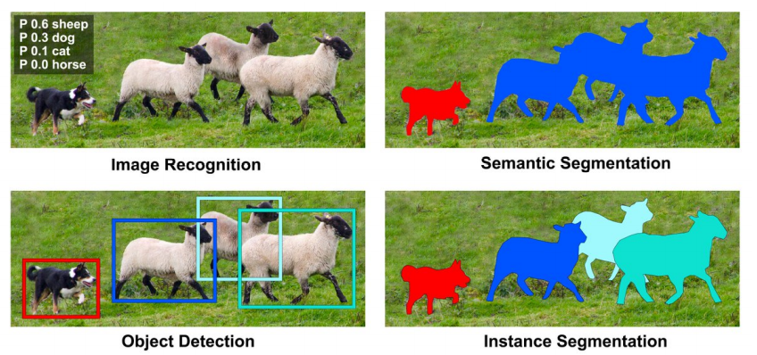
…to segmentation
Segmentation is the task of classifying each pixel in an image from a predefined set of classes. Two types of image segmentation exist:
Semantic segmentation refers to the process of linking each pixel in the given image to a particular class label
Instance segmentation treats multiple objects of the same class as individual objects / separate entities

Slide 7
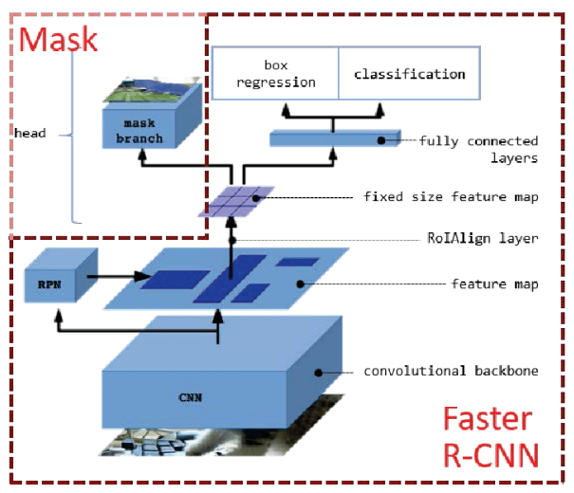
Segmentation networks
Mask RCNN:
extends Faster R-CNN to pixel-level image segmentation
it added a third branch for predicting an object mask in parallel with the existing branches for classification and localization
if we assume to have a high accuracy, so region of interest with a single instance, then semantic segmentation job is to just take in an image with exactly 1 main class, and predict which pixels correspond to the main class and which to the background

Slide 8
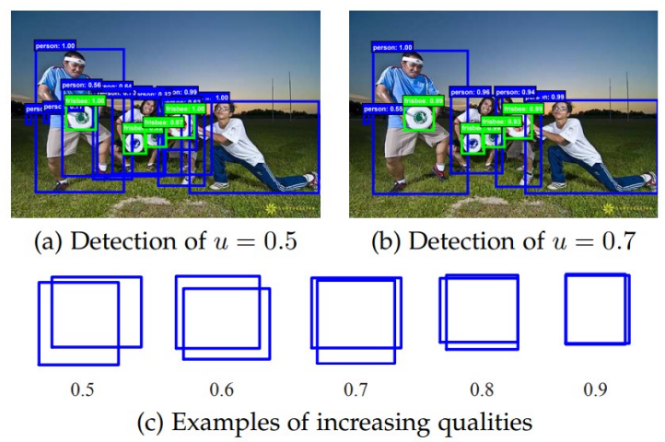
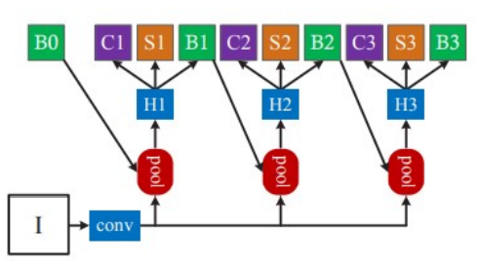
Segmentation networks
Problem: detectors frequently produce noisy bounding boxes. (many ”close” false positive, corresponding to ”close but not correct” bounding boxes)
Paradox of high quality detection: the detector will only achieve high quality if presented with high quality proposals, but increasing the threshold score usually degrades the performance, due to
Overfitting during training
Inference-Time mismatch
Cascade Mask RCNN:
multi-stage extension of Faster R-CNN proposed to solve the above problems
The cascade stages are trained sequentially, using the output of one stage to train the next (output of a Bbox Regressor is almost always better than its input)
Each stage is designed for one specific IoU threshold from small to large

Slide 9
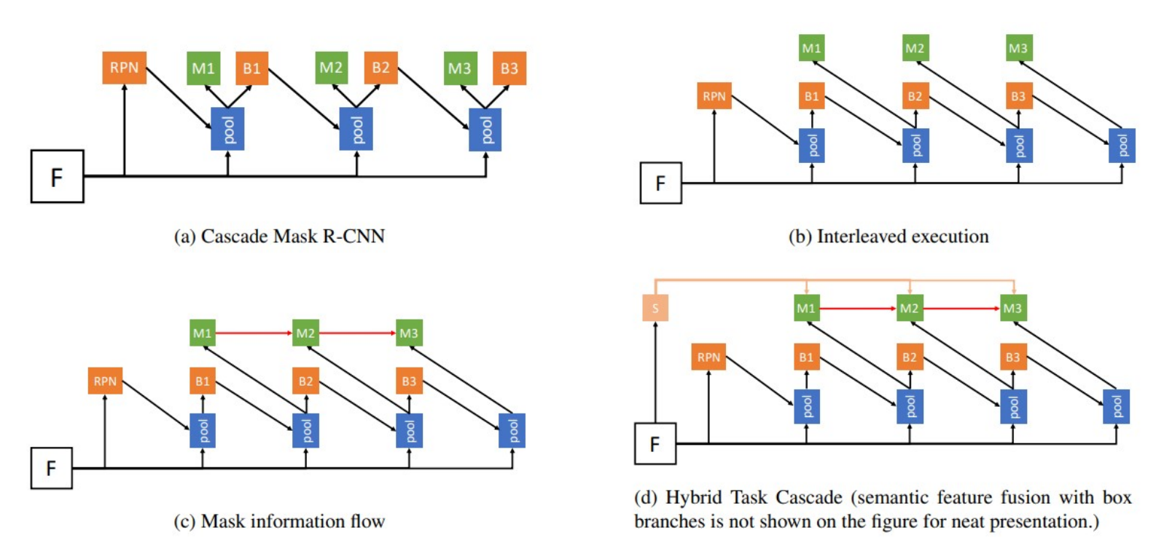
Segmentation networks
Hybrid Task Cascade:
Interleaved execution: in this way the mask branch can take advantage of the updated bounding box predictions
Information flow between mask branches is added, by feeding the mask features of the preceding stage to the current stage → progressive refinement of masks, instead of predicting masks on progressively refined bounding boxes
Spatial context: semantic segmentation for the hole images to be more discriminative on cluttered background

Slide 10



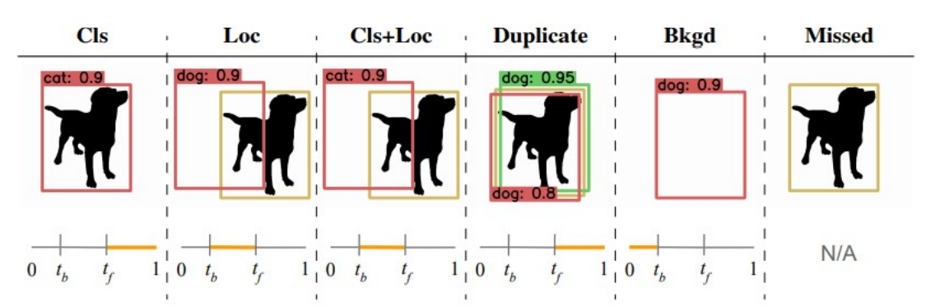
Toolkit
MMDetection: object detection toolbox based on PyTorch which provides a simple way to create a variety of detection deep learning networks (Faster RCNN, Mask RCNN, …) in an easy way
Google Colab: allows the use of the Jupyter Notebook service hosted on Google servers, with free access to computational resources, including Nvidia K80, T4, P4 and P100 GPUs and 12GB of RAM
Cocoapi: python library that assists in loading, parsing, visualizing and evaluating the annotations in COCO format
TIDE: general toolbox for identifying object detection and instance segmentation errors, decomposed in 6 types (Classification, Localization, Cls+Loc, Duplicate, Background, Miss

Slide 11
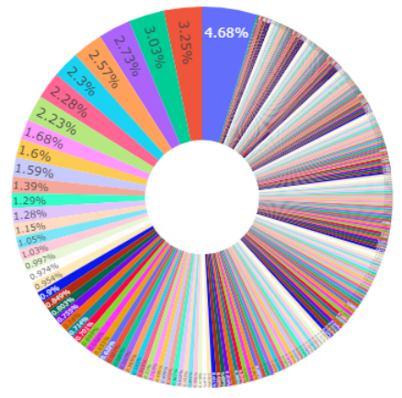
Dataset
AICrowd Food Recognition Challenge Dataset is composed of:
Training set: with 24.120 food images, with their corresponding 39.328 annotations in MS-COCO format
Validation set: with 1.269 food images, with their corresponding 2.053 annotations in MS-COCO format
273 Classes → Imbalanced
Max: Water 1853 images
Min: Veggie Burger 35 images
Average: 144 images

Slide 12
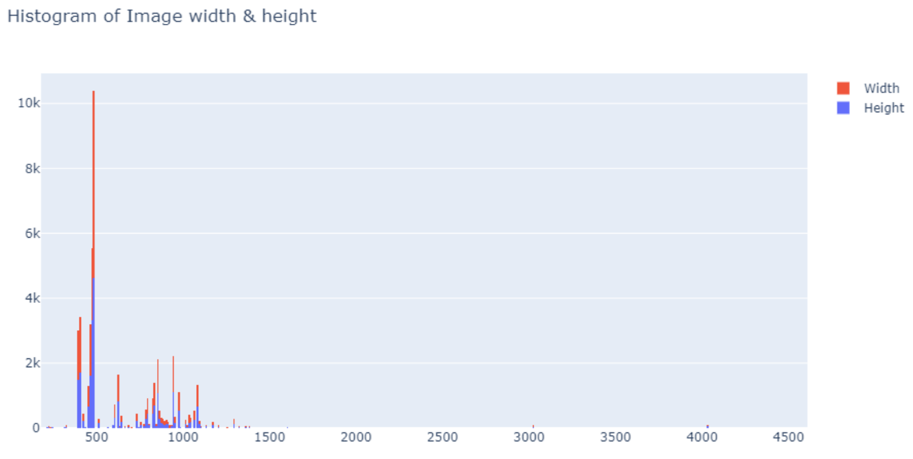
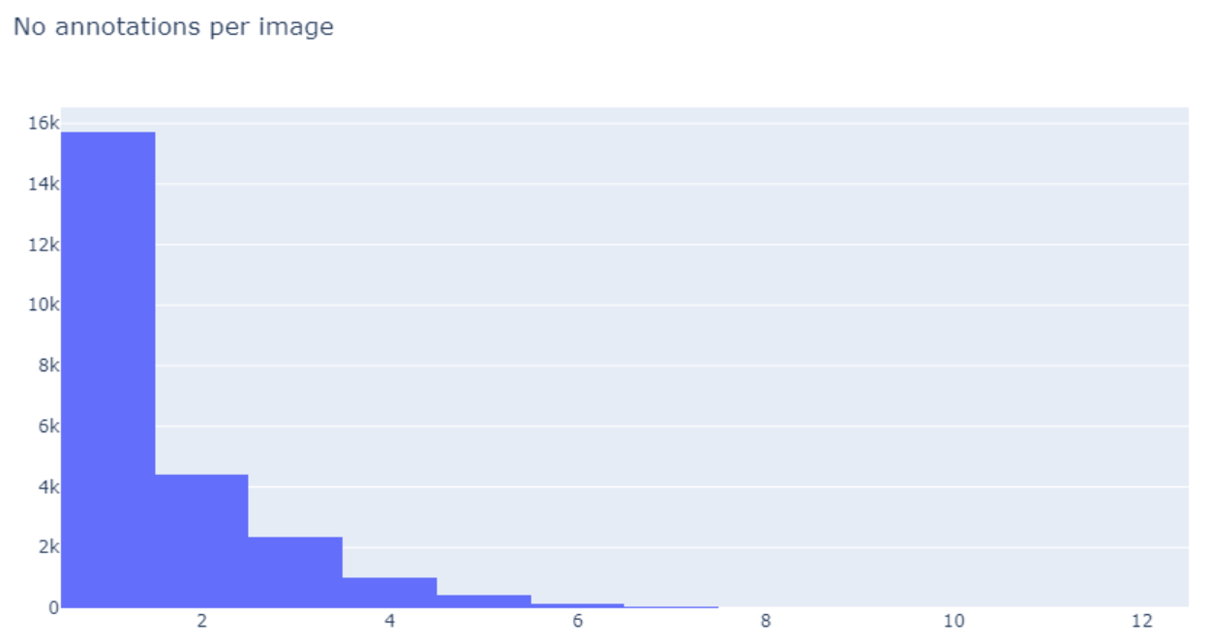
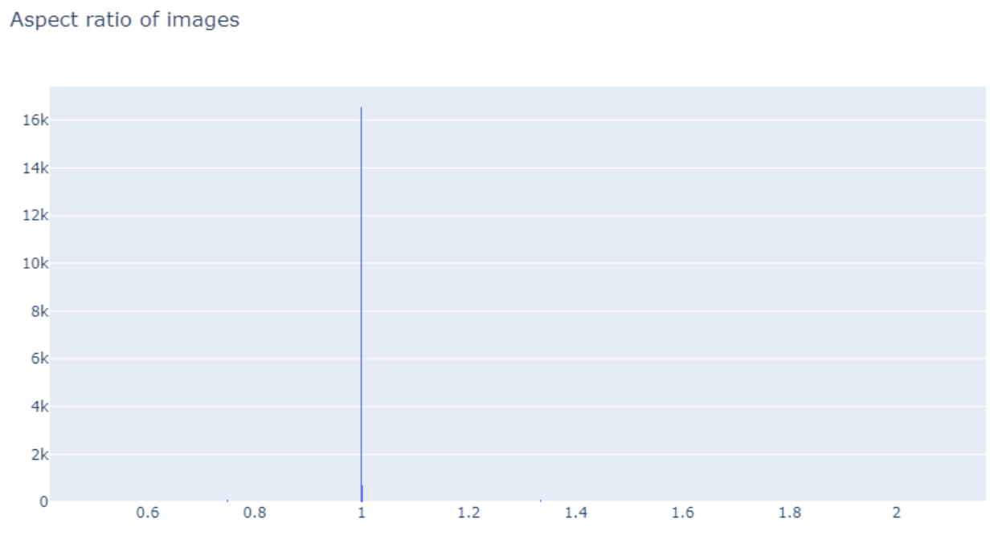
Data Exploration
Dimension of the images varies a lot
Many of the images are square
More than 15.000 images contains only one instance, only a few hundred contains more than 6 elements, the maximum is 12 in a single image

Slide 13
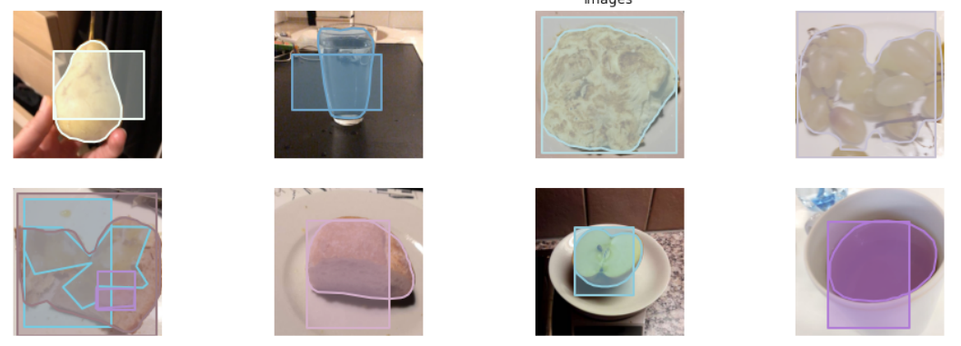
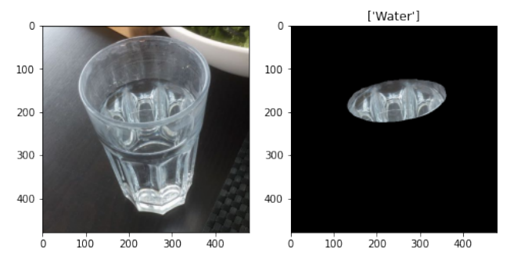
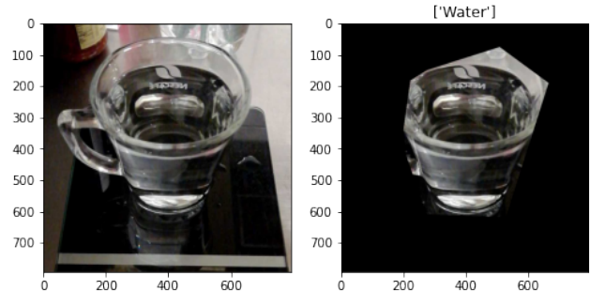
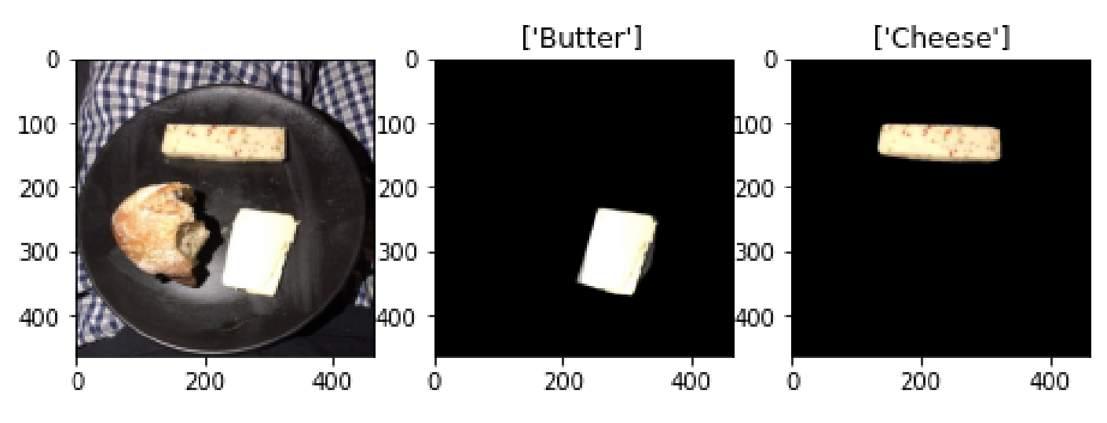
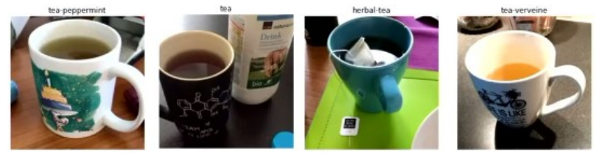
Data Exploration
The mask annotations have a very good quality, but the bboxes are not so precise, some of them are rotated or completely out of position with respect to the mask itself
Some difficulties that can affect the learning process:
Drinks are annotated in many different ways
Images not completely annotated
Some categories are difficult to recognize also for humans

Slide 14
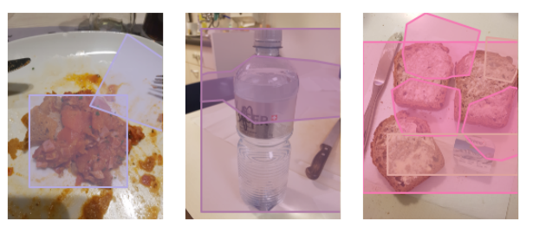
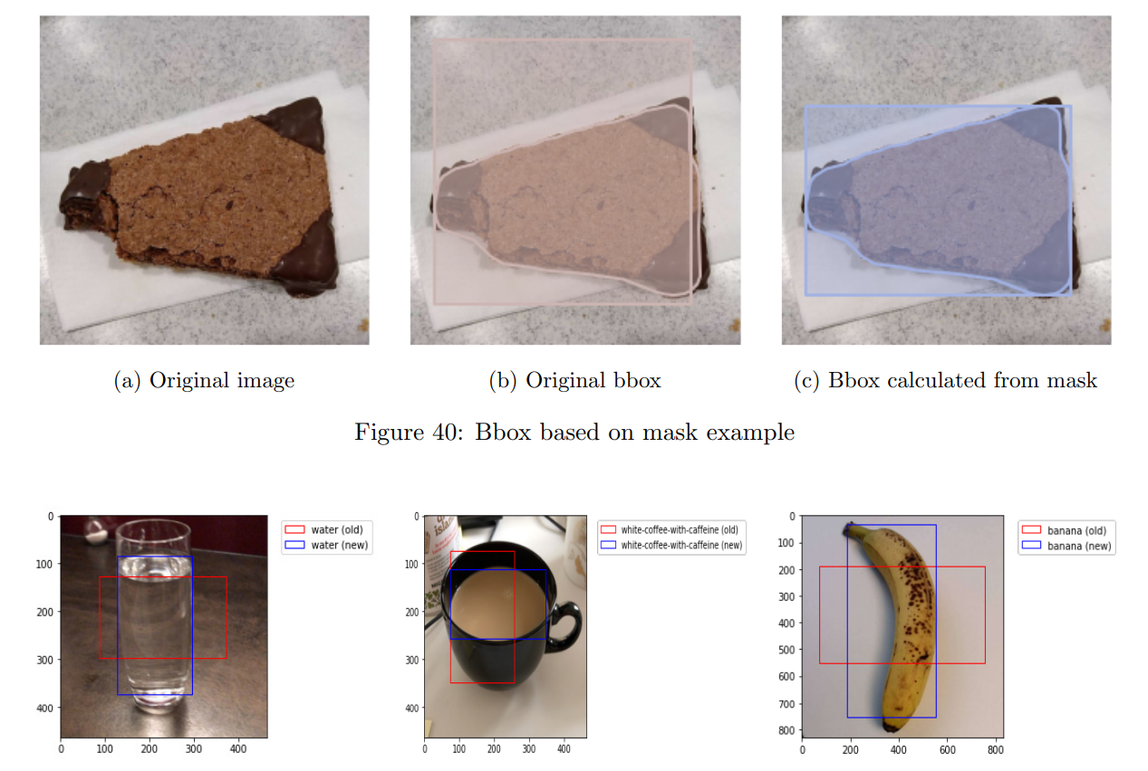
Data Preprocessing
INCORRECT ANNOTATIONS
Incorrect annotations: some of the images (27 in training set and 1 in validation set) have annotations which are rotated with respect to image with and height. In other words, there is a mismatch between image size and the sizes (for masks and bboxes) recorded in the COCO annotation files. These images make impossible to train the networks because they cause errors and raise exception during training
Solution: Modify the annotations by swapping image with and height in annotations data
Fix bboxes: Some of the bboxes are merely slightly off, but many are drastically of. If these bboxes were used for training they could cause problems as the models will be attempting to learn using incorrect bboxes
Solution: recreate the bboxes coordinates based on the masks and modify the annotation files
FIX BBOX

Slide 15
Experimental Study
Test three different state-of-the-art models for instance segmentation:
Mask RCNN
Cascade Mask RCNN
Hybrid Task Cascade
Backbone: ResNet50 due to less computational cost w.r.t deeper net
Transfer learning: pretrained weights on imageNet were used for the fist stage of ResNet because the weights learned in the first layers are likely to be independent from the particular kind of images they have been trained on
Multiscale training: images were resized to different scales at each iteration (range: [(480, 480),(960, 960)])

Slide 16
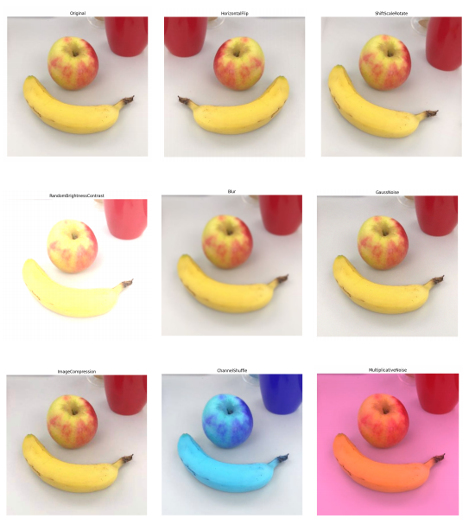
Data Augmentation
DATA AUGMENTATION TYPES
Data Augmentation by randomly applying some operations (rotation, zoom, shift, flips,. . . ) to the input data → the model is never shown twice the exact same example and has to learn more general features about the classes he has to recognize
Virtually increment the dataset size
Regularization technique, making the model more robust to slight changes in the input data
Applied variations of the training set images that are likely to be seen by the model → Channel shuffling not applied
Test Time Augmentation: perform random modifications to the test images, instead of showing the regular, ”clean” images, only once to the trained model, show it the augmented images several times. Then average the predictions of each corresponding image and take that as final guess
averaging our prediction we are also averaging the errors and possibly only the correct answer stand out

Slide 17
Hyperparameters
Batch size: we set the batch size as bigger as possible given our computational power, 4 was the higher possible dimension
Learning rate: we used the learning rate indicated in the default model configurations, 0.0025 without lr-decay
Warmup: is a way to reduce the primacy effect of the early training examples. The learning rate is increased linearly over the warm-up period. Therefore, the learning rate started from 0.0001 and was increased of 0.0001 in the first 500 iterations, until it reached the value of 0.0025
Optimizer: momentum optimizer was used to increase the learning speed. Instead of using only the gradient of the current step to guide the search, momentum also accumulates the gradient of the past steps to determine the direction to go. In this way we are able to reduce the oscillations in the gradient steps
We trained all the three models for only 10 epochs because of the huge computational cost, instead of the 12 default epochs defined in MMDetection library and the 20 epochs used in AICrowd Challenge examples

Slide 18
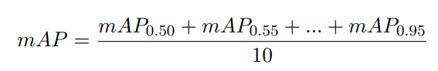
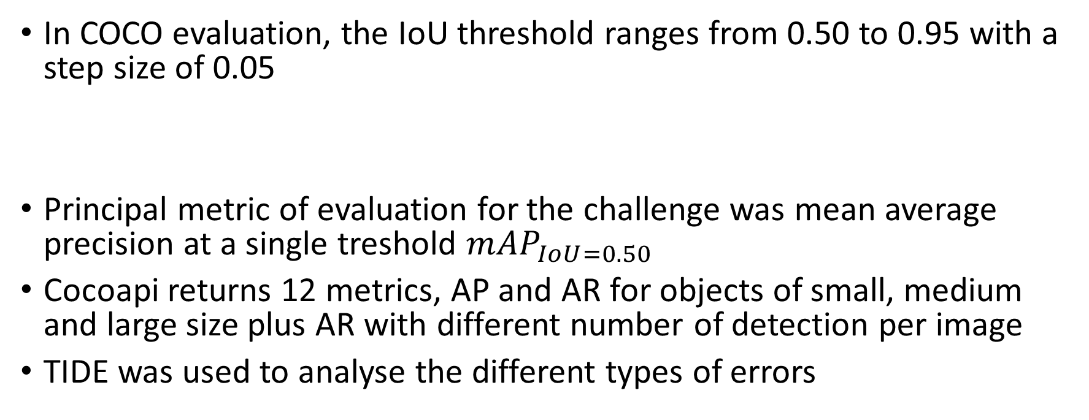
Evaluation Criteria
In COCO evaluation, the IoU threshold ranges from 0.50 to 0.95 with a step size of 0.05
Principal metric of evaluation for the challenge was mean average precision at a single treshold ${mAP}_{IoU=0.50}$
Cocoapi returns 12 metrics, AP and AR for objects of small, medium and large size plus AR with different number of detection per image
TIDE was used to analyse the different types of errors

Slide 19
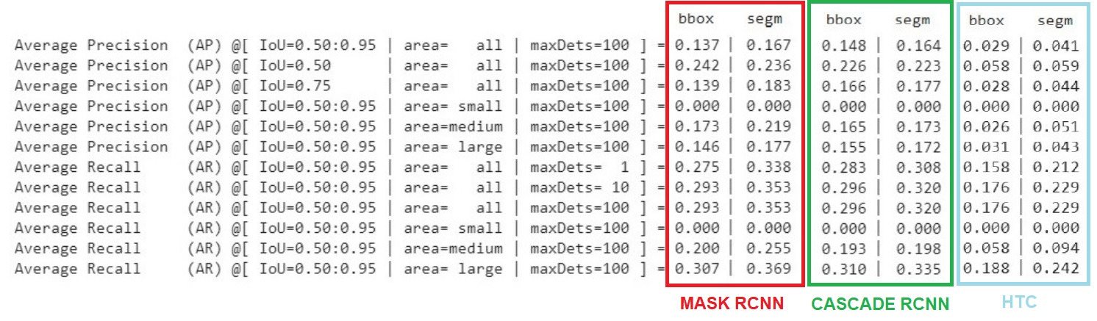
Experiment 1 - Results
The models performance for AP is slightly the same for detection and semgmentation tasks
The recall related measures are all better for segmentation task → the amount of false positive is greater in the case of detection task
Mask RCNN obtains the best results
Unexpectedly , the Hybrid Task Cascade model has poor performance compared to the other models

Slide 20
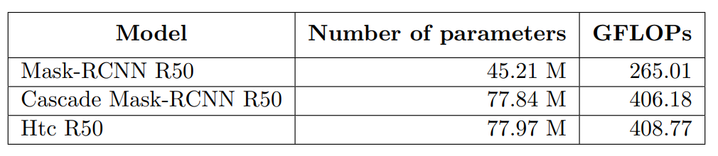
Results
The fact that the HTC model get worse results than the others two models, even if it should be the most powerful model, can derive from the fact that the number of parameters for this model is higher and therefore it requires a longer training time.
Instead, we trained all three models for the same amount of time (ten epochs).
We can see this phenomenon also by comparing Mask-RCNN model and Cascade Mask-RCNN model, the second is more powerful then the first, but it does not overcome the other given the same amount of training time.
However, the number of operations and parameters of Cascade Mask-RCNN and HTC is quite similar, but the second get results that are much worse than the first. This could be due to the random weights initialization, the models start learning from different points in the search space and the first achieve a better result.

Slide 21
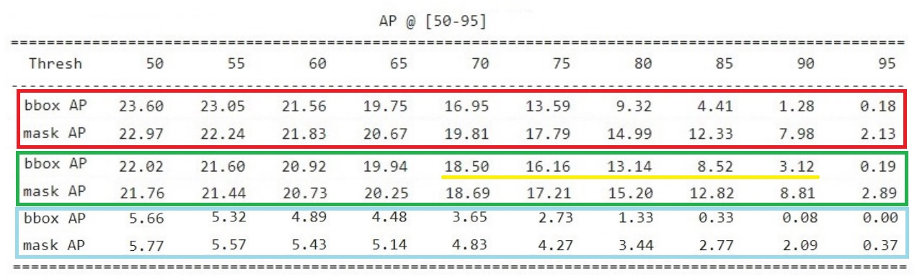
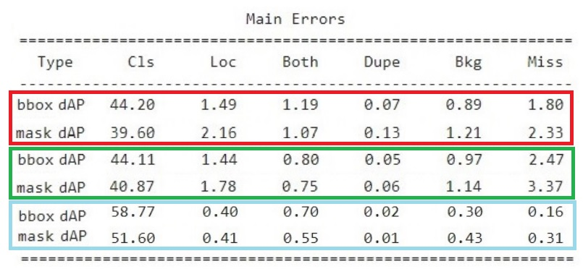
Results
Cascade RCNN obtains better results at higher thresholds w.r.t. the other models
Mask RCNN get better results at lower thresholds
Classification is the main source of error in all the cases
Miss GT is the second type of error but is extremely low if compared to classification

Slide 22
Experiment 2 - HTC Pretrained
We tried to train again the Htc model, but this time we started by using available weights from Round 2 of AICrowd food recognition challenge.
In the second round of the challenge only 60 categories were available, compared to the 273 of the last round. The weights refers to a model trained for 20 epochs with ResNet50 as backbone.
We also made some modifications to try to make the learning process more effective:
we have changed the weight associated to the classification loss, we increased it from 1.0 to 2.0, to try to correct the problems highlighted previously;
we lowered the maximum number of detections per image from 100 to 30, this because the maximum number of items in a single image is 12;

Slide 23
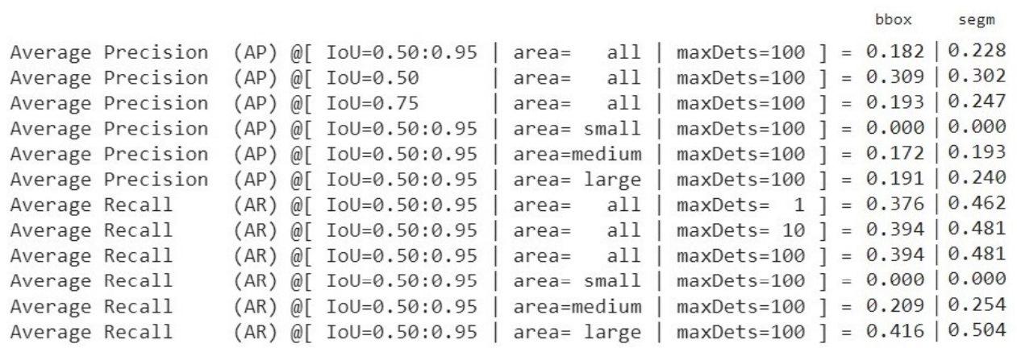
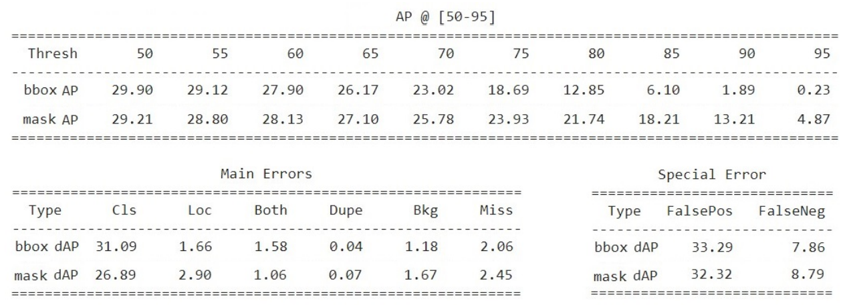
Results
The difference between this experiment and the previous is huge
We get the best result obtained among all the tested models
Classification error dropped down to 26.89 for segmentation
Reuse weights has been very useful
Increasing the weights for classification loss could be useful to focus the model more on this type of errors;

Slide 24
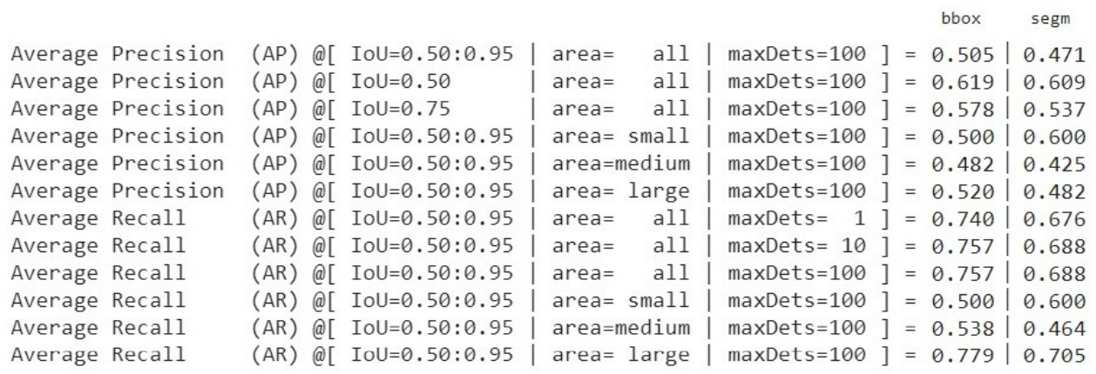
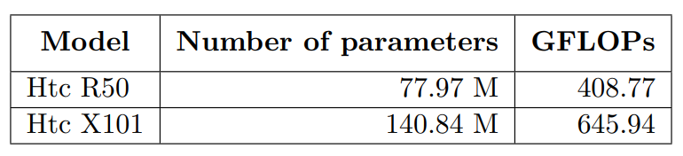
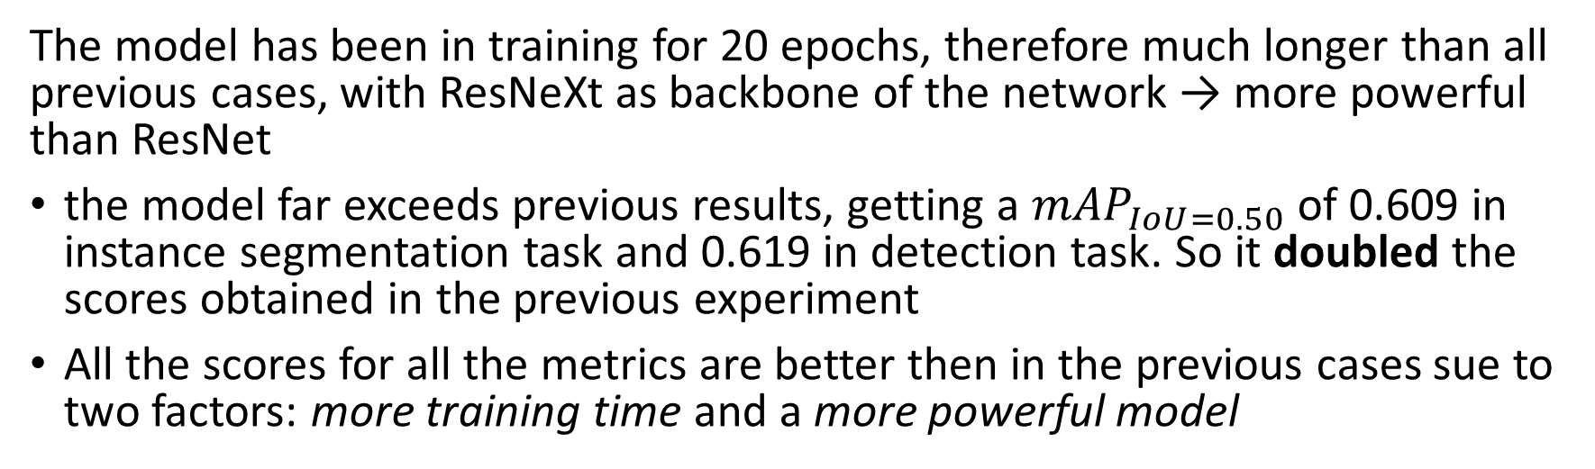
Experiment 3 - HTC X101
The model has been in training for 20 epochs, therefore much longer than all previous cases, with ResNeXt as backbone of the network → more powerful than ResNet
the model far exceeds previous results, getting a ${mAP}_{IoU=0.50}$ of 0.609 in instance segmentation task and 0.619 in detection task. So it doubled the scores obtained in the previous experiment
All the scores for all the metrics are better then in the previous cases sue to two factors: more training time and a more powerful model

Slide 25
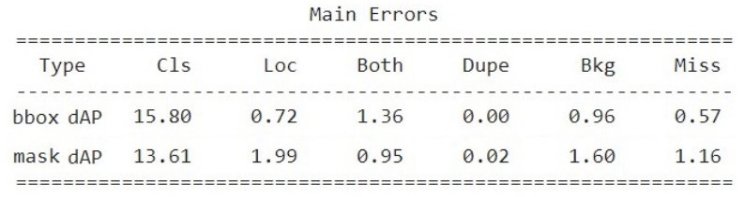
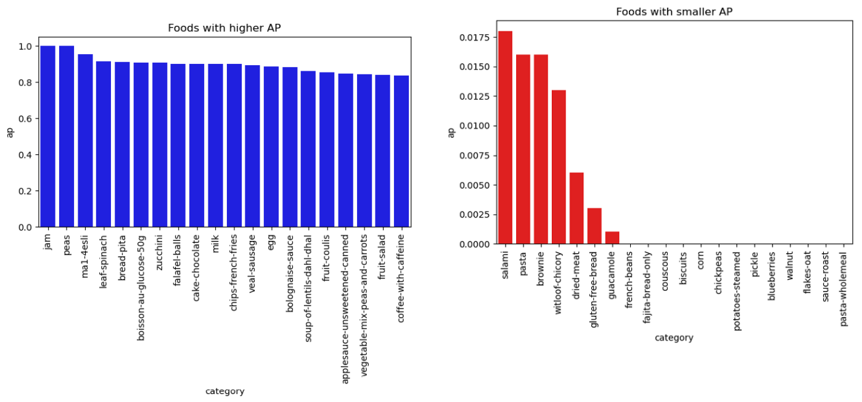
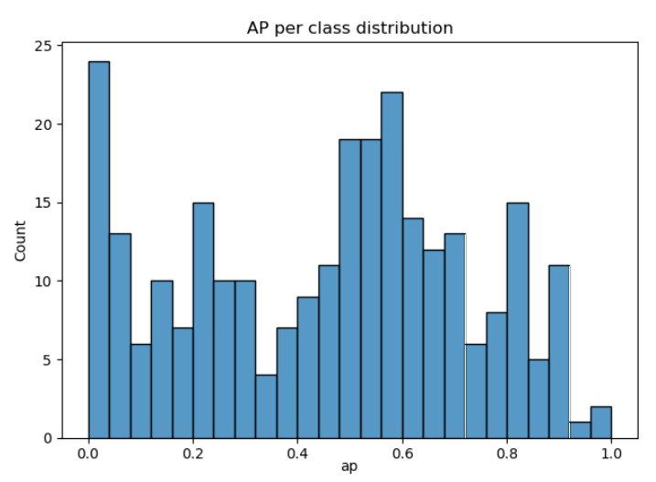
Class-wise analysis
The classification error has more than halved, however it still remains the main source of error
Class-wise analysis to try to determine if some of these categories mostly affect the results:
we can notice a big difference among AP of the various classes
there is not a direct correlation between the number of images per class in the training set and the average precision values obtained for the categories: categories with many images and categories with a small number of images that obtain good and bad AP scores

Slide 26
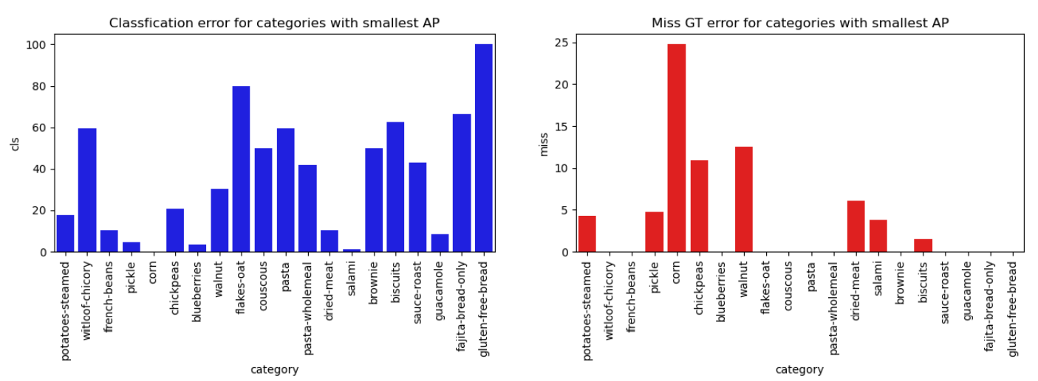
Class-wise analysis
Different classes have different main types of error
More than 35 classes does not have classification error, but there are also many classes with very high classification error
For the other types of erros (localization, background, miss GT) we can see that a very small number of classes have high values for them, meaning that the algorithm is quite good in localization of items and distinction between background and foreground.

Slide 27
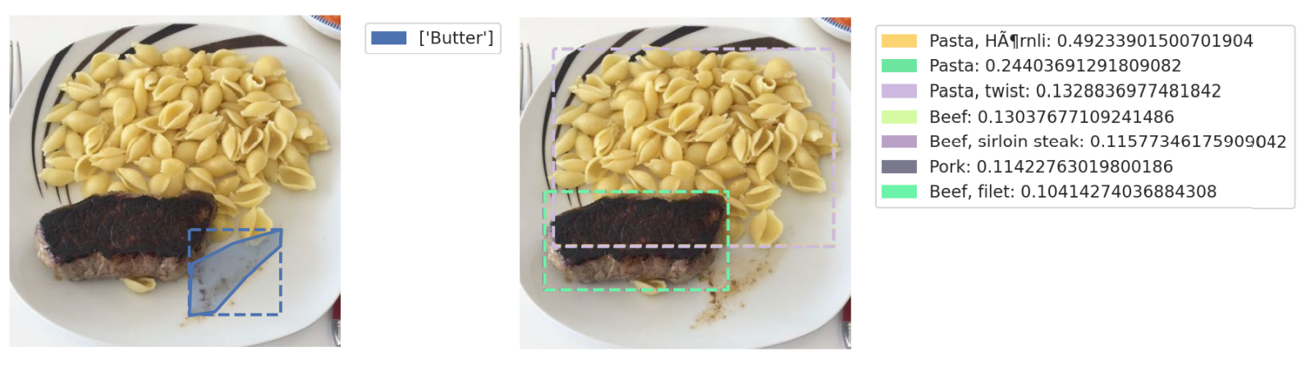
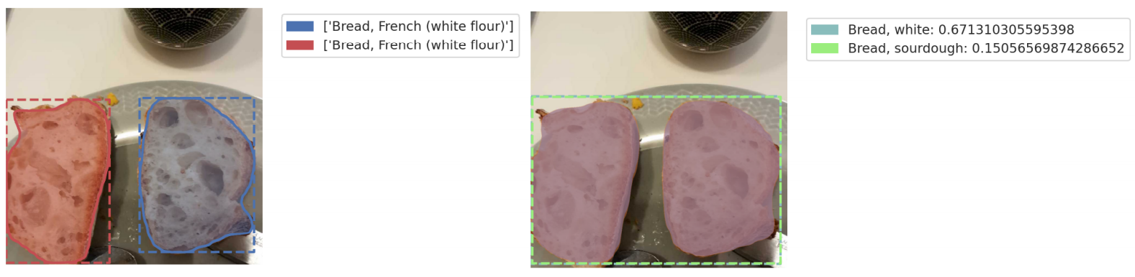
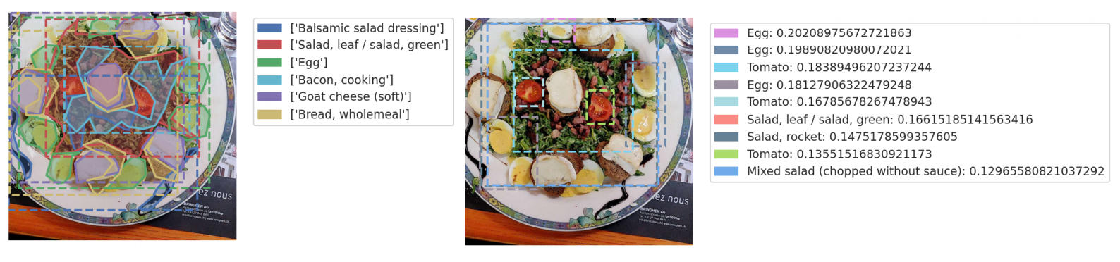
Class-wise analysis
These errors in some cases are caused by the problems already noticed in Data Exploration:
images partially annotated or not perfectly annotated
categories very similar among them
Overlapped items are more difficult to recognize

Slide 28
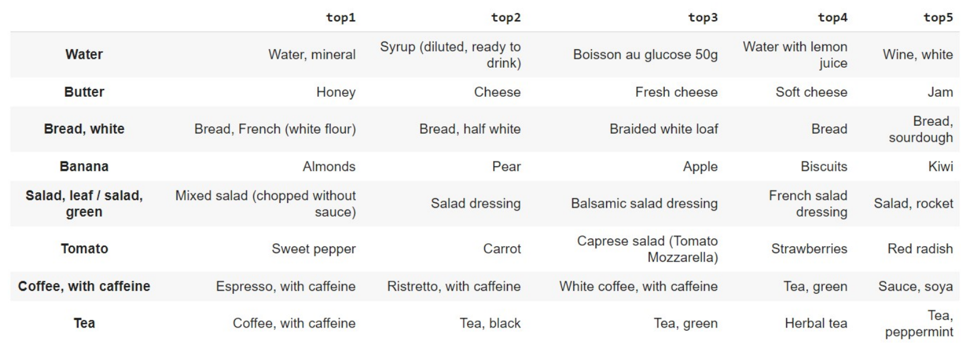
Class-wise analysis
There are some categories for which we have many common mistakes:
Water is sometimes confused with other light coloured drinks, like syrup or white wine;
Coffee, Bread and Tea are confused with similar categories;
Butter is typically confused with cheese;
Tomato is confused with other red food items, like Strawberry and Pepper

Slide 29
Conclusions
Food image segmentation is a very interesting, but also difficult problem:
SOTA models perform very well on segmentation and detection tasks, they output bounding boxes and masks with no problem and low error.
However, the models have difficulties in the classification task, likely due to the large number of very similar classes.
The dataset is quite large and well annotated, but there are still some problems that need to be fixed and that can affect the learning process
Training require a very long time and transfer learning, not surprisingly, is very useful to help the models converge faster and to increase the models performance
This models could be used as a base tool for interesting applications, such as mobile apps that track users food consumption, estimate food weights, calculate food calories, or also for the automatic creation of diets etc.

Slide 30
Future Work
We obtained good results with the tested convolutional neural networks, but we can also think to some other pre/post process that could be useful to improve the current results:
reformat the classes: remove similar categories that are difficult to recognized also for humans and which we have proven to be the major source of error;
reduce the class imbalance: this makes the problem very interesting from the perspective of machine learning, but also very hard because this affects the learning process in a negative way;
oversampling techniques: these techniques could be used to try to solve the imbalance problem by oversampling the classes with less images;
ensemble learning techniques: to ensemble predictions from different models based on confidence scores;

